Slide 1


Presented by Jagruthi Manchi Saraf
Supply Chain Analysis
for Fashion and Beauty Products
Notes:
Hello, everyone my name is jagruthi manchi saraf. i have selected Supply chain analysis for the powerBI project.

Slide 2

Introduction to Supply Chain
Supply chain analytics is key to optimizing operations across industries. In the Fashion and Beauty sector, especially for makeup products, it ensures efficient movement from suppliers to customers. This analysis for a startup reveals insights to boost efficiency, cut costs, and meet demand in a competitive market
Notes:
Supply chain refers to the entire process of moving products from creation to delivery to customers.
For instance, when you order a makeup product online, the manufacturing team prepares your order, ensuring it's packed securely.
The product is then transported using various methods—like trucks, ships, or planes—before being shipped to a store or directly to your home. Finally, it reaches you, the customer.

Slide 3

About the Dataset
This dataset from a Fashion and Beauty startup offers a detailed view of the makeup product supply chain. Key features include product details, pricing, stock levels, customer demographics, shipping data, and supplier information. Each feature provides insights to optimize inventory, reduce costs, and enhance customer satisfaction, delivering a comprehensive view of the supply chain process
Notes:
This dataset from a Fashion and Beauty startup provides a comprehensive overview of the makeup product supply chain.
It includes key features such as product details, pricing, stock levels, customer demographics, shipping information, and supplier data.
Each feature offers valuable insights for optimizing inventory, reducing costs, and improving customer satisfaction, creating a complete picture of the supply chain process.

Slide 4

Whats in the DashBoard?
Our dashboard analyzes the makeup supply chain, highlighting revenue, costs, order trends, and quality metrics to support efficient, data-driven decisions
Notes:
Our dashboard provides a comprehensive analysis of the makeup supply chain, highlighting key metrics such as revenue, costs, order trends, and quality indicators.
These insights support efficient, data-driven decision-making. Let’s dive into the dashboard to explore how we can enhance our operations together.

Slide 5
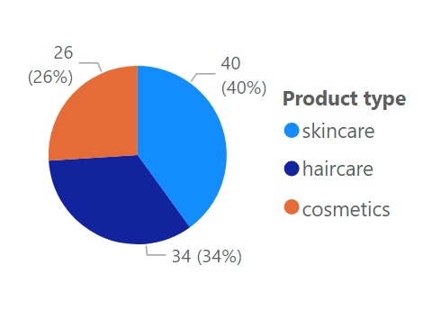
Product Types
Notes:
Skincare is the largest category at 40%.
Haircare follows with 34%, and cosmetics are at 26%.
This data shows that most consumers are more interested in skincare products than in cosmetics.

Slide 6
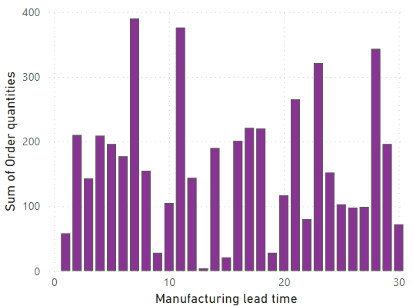
Order Quantity by Manufacturing lead Time
Notes:
This graph illustrates the relationship between order quantity and manufacturing lead time.
We can see that higher order quantities are associated with shorter lead times.
For instance, when the order quantity is 390, the manufacturing lead time is only 7 days. In contrast, with a much lower order quantity of 4, the lead time increases to 13 days.
This suggests that increasing order quantities can help reduce manufacturing lead times, ultimately improving our supply chain efficiency.

Slide 7
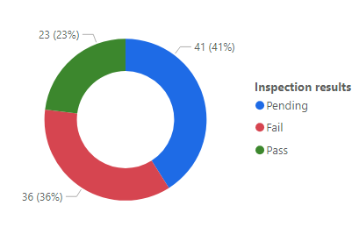
Inspection Outcomes Distribution
Notes:
This donut chart shows the distribution of inspection outcomes in three segments: pending, fail, and pass. Currently, 41.4% of inspections are pending, while 36% have failed.
Only 23% of products have passed inspection.
This means that a large number of our products are either awaiting review or haven't met quality standards, which highlights the need to improve our quality control processes.

Slide 8
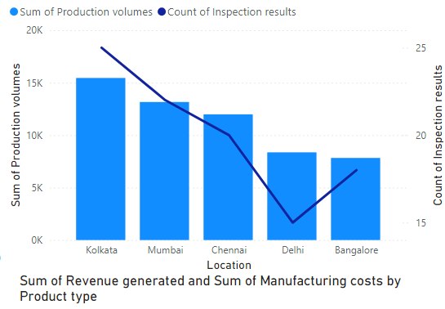
Production Volumes and Inspection Outcomes by Location
Notes:
This chart shows production volumes and inspection outcomes across locations: Kolkata, Mumbai, Chennai, Delhi, and Bangalore.
Kolkata leads with the highest production volumes and inspection results, indicating strong manufacturing and quality control.
In contrast, Delhi has the lowest inspection results, suggesting potential quality issues that need attention.
Meanwhile, Bangalore records the lowest production volumes, indicating an opportunity to enhance capacity and efficiency there.
Overall, we need to improve quality in Delhi while leveraging Kolkata’s strengths and addressing the challenges in Bangalore to optimize our supply chain.

Slide 9
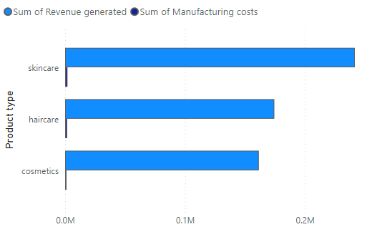
Revenue vs. Manufacturing Costs by Product Type
Notes:
clustered bar chat
Skincare products generate the highest revenue while also having the greatest manufacturing costs, indicating a strong demand and successful market positioning in this category.
In contrast, cosmetics have the lowest revenue and manufacturing costs, suggesting that this segment may not be performing as well and could benefit from targeted marketing or product development strategies.
Overall, focusing on maximizing the profitability of skincare while finding ways to enhance the performance of the cosmetics line could be beneficial for our business

Slide 10
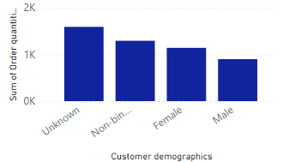
Order Quantities by Customer Demographics
Notes:
clustered column chart
The 'unknown' category has the highest order quantities, which may suggest a lack of accurate customer data or many customers choosing not to disclose their gender. Non-binary customers follow with significant orders, indicating a receptive market. In contrast, female and male customers show lower order quantities, pointing to potential gaps in engagement and marketing strategies.
Overall, these insights can help us refine our marketing and product offerings to better serve all customer groups."

Slide 11
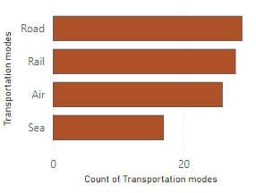
Distribution of Transportation Modes
Notes:
stacked bar chat
Road transportation is the most utilized mode, likely due to its flexibility and ability to reach various destinations efficiently.
Rail comes next, offering a reliable option for bulk shipments.
Air transport is used less frequently, as it tends to be more costly, while sea transport is the least utilized, often chosen for larger shipments that require longer transit times.
Understanding this distribution helps us optimize our logistics strategies and cost management based on the most effective transportation modes

Slide 12

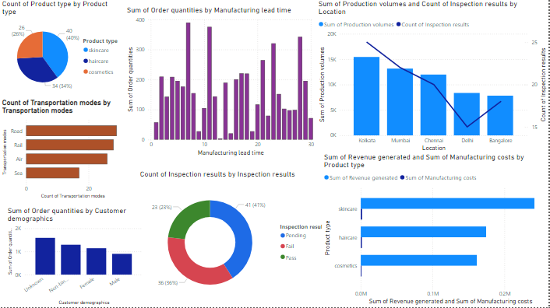

Dashboard

Slide 13

Presented by Jagruthi Manchi Saraf
Thank you very much!

